Slide 1
EmpowHer
EmpowHER: Empowering Girls for Corporate Excellence Soft Skill Curriculum <DATA>

Slide 2

Agenda
Introduction to Data Governance & Analytics
Introduction to BI Tools
Alteryx Power BI Tableau

Slide 3
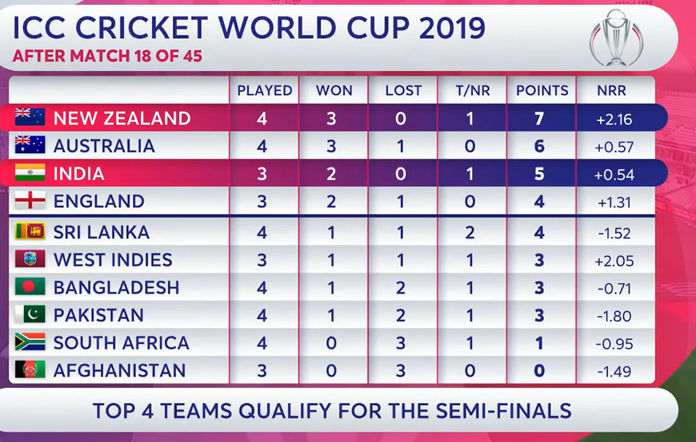
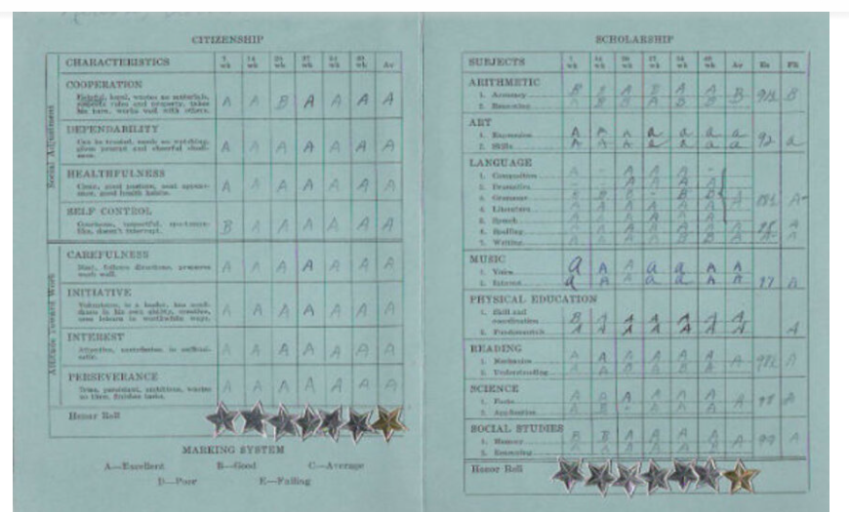
DATA Everyday

Slide 4
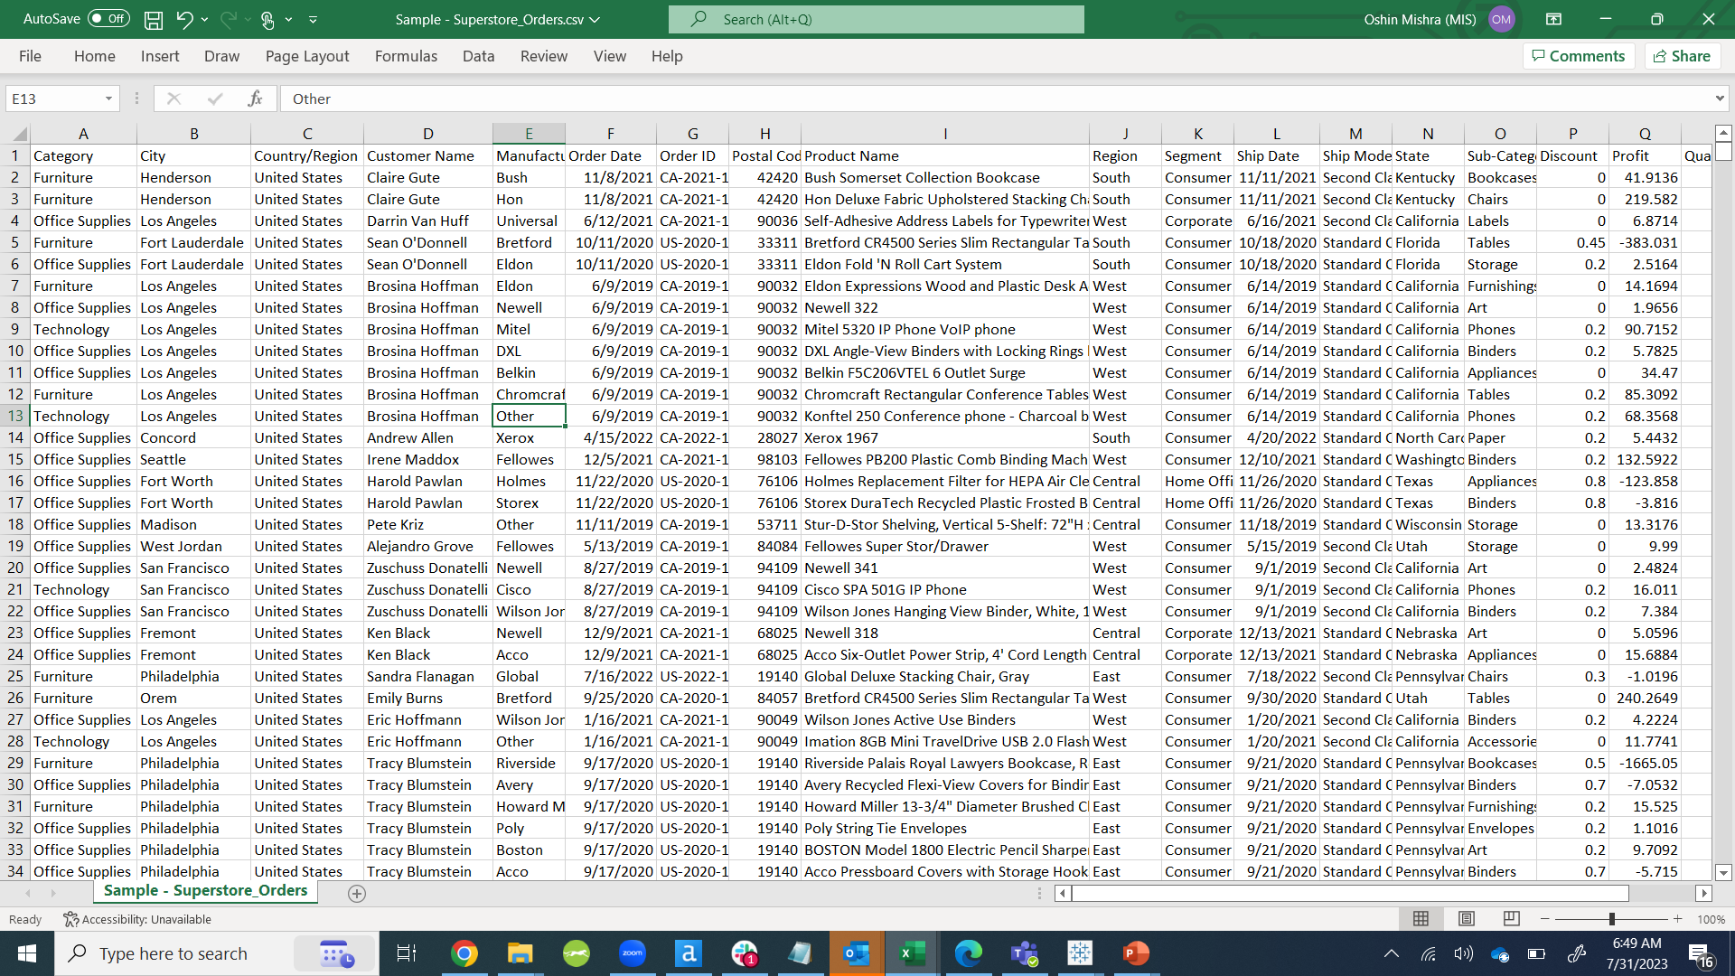
Data (RAW)

Slide 5
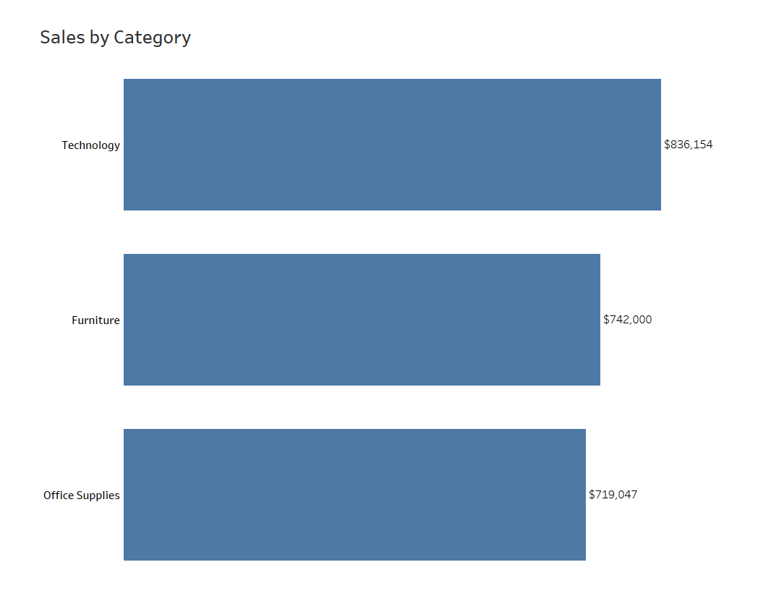
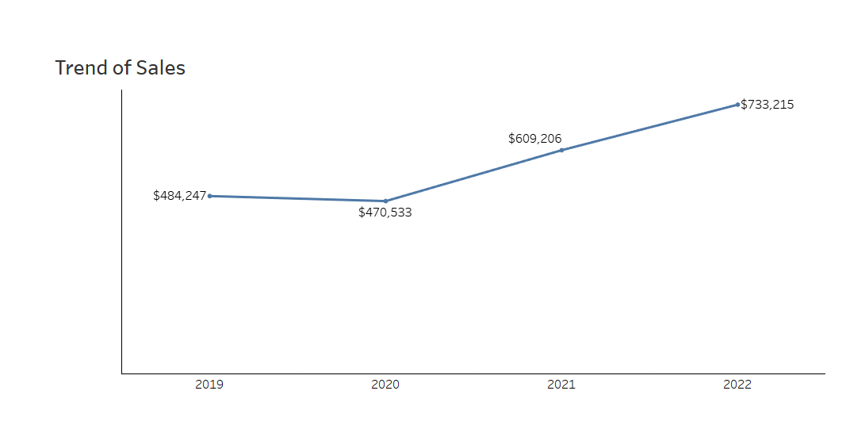
Visualization

Slide 6
Welcome to Mesmerizing World of Data
Drowning in data, but starved of information
Need a good Data Governance model
What Aspects of Data Can Be Governed
Notes:
Drowning in data, but starved of information: This idiom is used to describe a situation where there is an abundance of data, but a lack of useful, actionable insights. How we can derive insights from data points, is first to know why the data has to be used, where it has to be used, what could be possible sources of data, what structure to choose (e.g. for a Flag do u need Y / N, 1 / 0 etc).
Data governance is an emerging, cross functional management program that treats data as an enterprise asset. New roles and responsibilities exist in data governance as well as tools and technologies to facilitate data governance program. Data governance also includes the oversight necessary to ensure
compliance and manage risks.
Aspects of Data that can be governed: Data ownership and accountability, Data access (who, when, where, what), Data quality levels, Data handling (creation, updating, deleting), Data storing (archiving, security), Data definitions, Data allowable values, Data architecture, Reporting

Slide 7
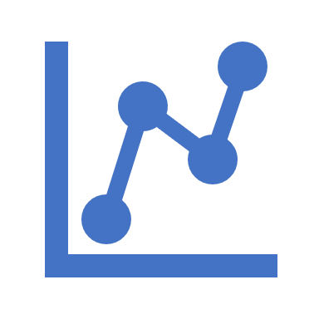
What is Data Analytics?
Analytics is the use of:
Data
Information technology
Statistical analysis
Quantitative methods
Mathematical or computer-based models
To help managers:
Gain improved insight about their business operations
Make better, fact-based decisions.
Notes:
One off the most key deliverables for a data analyst is to curate and interrogate data at optimized speed to deliver intelligent insight-driven services that clients need today to help prepare them for a better tomorrow. From corporate strategy to capital allocation to M&A, the advanced analytics teams underpin and inform planning through to execution to help create bespoke, sector-driven value for clients.

Slide 8
6 Steps to Data Analytics
1
Goals setting
Vital, understandable, simple, short, and measurable goals
2
4
5
6
3
Setting priorities for measurements
Decide what to measuring, and what methods to use for measure it
Data gathering
Available datasets, recording/generating data
Data cleansing
Outlier rejection, missing values interpolation, data structuring
Data analysis
Data mining, business intelligence, data visualization, exploratory data analysis
Precise results’ interpretation
Checking whether they are helpful in meeting initial objectives, results limiting, or inconclusive
Business Unit to decide on objectives for data analytics
E.g. – are the products overpriced; do we target a different geography
How much time to take for the analysis of the project
Determining what type of data is needed to answer the questions regarding objectives
Leverage the existing and available data sets avoiding any replication of data
It helps identifying
Incorrect
Inaccurate
Irrelevant parts of the data
Incomplete

Slide 9
Introduction to Data Analytics
Data analysis is an integral part of nearly every job role in business today
Data is ever-present and strongly influences individual and organizational performance
The ability to confidently navigate the path from data to information, understanding, decision, and action is a key characteristic of top performers
Turn data points into connected intelligent insights for better decision-making
Notes:
One off the most key deliverables for a data analyst is to curate and interrogate data at optimized speed to deliver intelligent insight-driven services that clients need today to help prepare them for a better tomorrow. From corporate strategy to capital allocation to M&A, the advanced analytics teams underpin and inform planning through to execution to help create bespoke, sector-driven value for clients.

Slide 10

ALTERYX
What is Alteryx?
Definition: Alteryx is a leading data analytics platform that allows users to blend data from different sources, create workflows, develop predictive models, and share insights across the organization. It is designed to make advanced analytics accessible to any data worker.
Why Alteryx?
You can automate time-consuming and manual data tasks, while performing predictive, statistical, and spatial analytics in the drag and drop interface. It makes it easier to discover, share and prep data, perform analysis, and deploy and manage analytic models
Key Features of Alteryx:
Data Blending: Combine data from disparate sources into a single, ready-to-use dataset.
Data Preparation: Extract, Transform, Load (ETL)
Advanced Analytics: Use predictive, statistical, and spatial analytics tools to uncover trends and patterns.
Automation: Automate manual data tasks and create repeatable workflows.
Reporting: Easily create reports and share insights across your organization. (Source: Alteryx)
Learning Resources:
Alteryx Academy: Offers interactive lessons and videos to help you learn Alteryx.
Alteryx Community: A platform where you can ask questions, share knowledge, and learn from other Alteryx users.
Alteryx Toolset: A comprehensive guide to the tools available in Alteryx.
Getting Started with Alteryx:
Alteryx Designer: The main application where you can create workflows, blend data, and perform analytics.
Alteryx Server: Allows you to share workflows, schedule tasks, and perform analytics in a secure, scalable environment.

Slide 11

TABLEAU
What is Tableau?
Tableau is a leading data visualization tool that transforms raw data into easily understandable visual formats.
Purpose: It helps in simplifying raw data into a very easily understandable format.
Features of Tableau
Interactive Dashboards: Create and share dashboards that depict trends, variations, and density of the data in the form of charts and graphs.
Data Blending: Allows you to blend different relational, semi-structured and raw data sources in real-time, without expensive up-front integration costs.
Real-Time Analysis: Lets you analyze data in real-time.
Collaboration of Data: It allows for data collaboration and data governance.
Why Use Tableau?
User-Friendly: Requires minimal technical knowledge and is easy to learn and use.
Powerful Visualizations: Can handle vast amounts of data and convert it into interactive visualizations.
Speed: Tableau is 10-100x faster than existing solutions.
Applications of Tableau
Business Intelligence: Helps organizations understand their data and make informed business decisions.
Academic Research: Used by researchers to visualize research data.
Journalism: Used by journalists to tell data-driven stories.
Learning Tableau
Tableau offers a variety of resources for learning, including online tutorials, webinars, and certification programs.

Slide 12

POWER BI
Power BI is a unified, scalable platform for self-service and enterprise business intelligence (BI). Connect to and visualize any data, and seamlessly infuse the visuals into the apps you use every day.
Why ?
Connect to millions of data from various sources
Build relational model
Recognized as a leader in Gartner Magic Quadrant, 2023
200 over DAX(Data Analysis Expressions) , categorized text functions, aggregation functions, filter functions, financial functions, and etc.
Get unparalleled Excel interoperation
Anyone who’s familiar with Microsoft 365 can easily connect Excel queries, data models, and reports to Power BI Dashboards—helping to quickly gather, analyse, publish, and share Excel business data in new ways.
Go from data to insights and insights to action with Microsoft Power Platform—combining Power BI with Power Apps and Power Automate to easily build business applications and automate workflows.
Reinvent report building with Copilot in Power BI
Components of Power BI
Power BI Desktop, Power Query, Power Maps, Power Q & A, Power BI Service

Slide 13
Appendix
Tableau:
https://www.tableau.com/learn/training
Power BI:
https://learn.microsoft.com/en-us/training/powerplatform/power-bi?WT.mc_id=powerbi_landingpage-marketing-page
Alteryx:
https://community.alteryx.com/t5/Maveryx-Academy/ct-p/alteryx-academy?_ga=2.196287596.1311236294.1690982331-1540937773.1677580241

Slide 14

Q&A

